Slide 1

Arrays
Lecturer
Rokas Slaboševičius
Data

Slide 2
Today you will learn
Arrays
Arrays
01
String array operations
02

Slide 3
What are arrays?
Arrays
An array is a data type that holds many values of the same data type.
You can think of it as a wardrobe where you can put one item on each shelf, but on the condition that all the items in the wardrobe are of the same type, e.g. only trousers, only screwdrivers, only lamps.
In programming terms, you could store a handful of strings or numbers or booleans in an array.

Slide 4
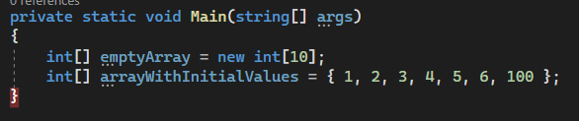
What are arrays?
Arrays
There are two ways to create an array variable:
We initialize the array and tell it to hold 10 elements.
Initialise the array by specifying the elements inside the array at once

Slide 5
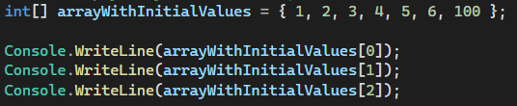

What are arrays?
Arrays
If we want to access elements within an array, we have to use an array variable and enter an index in [] (square brackets) that tells us which element we want to access.
Indexing starts from 0 instead of 1, so to access the first three elements of the array the code would look like this:

Slide 6
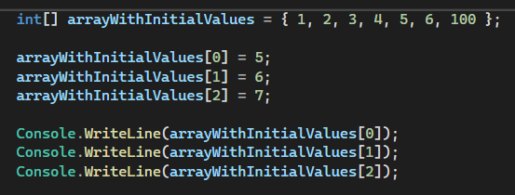

What are arrays?
Arrays
To change the values by index:
If we were to create an array without initial values, all values in the array would have to be determined in this way.

Slide 7
Important aspects
Arrays
When initializing the array without entering your own values, the program will use the default values of the data type:
string - null
int - 0
It is not possible to change the size of the array (the only way is to create a new larger array and move the values of the old one)
An array is a reference type, so if you pass it to a method or another variable and change the values of the elements, the elements of the original array will change.
Deleting an item from an array is not possible as the array size is fixed (the only way is to create a new smaller array and move the values of the old one without the one you want to delete)

Slide 8
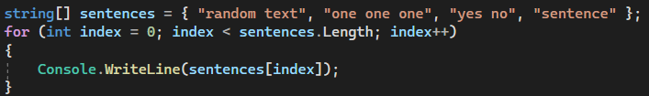
Iteration through an array
Arrays
As you have already seen, the elements in the array are accessed using a number, which means that we can also put a number variable in there, which means that we can put a variable from the for loop, which tells us which iteration of the loop it is. We try to print an array of string data type using a for loop.
We have created an array of string data type,
we immediately put 4 values inside (this means,
that the array will be of size 4 elements).
Then, when describing the array, we say that iterations will take place until i is less than the array's property Length. At this point
it is worth mentioning that Length is like a length variable in mathematics, it describes the length of the array and since the array is indexed from 0, if we iterate the loop until i is less than or equal to Length we will encounter NullPointerException

Slide 9
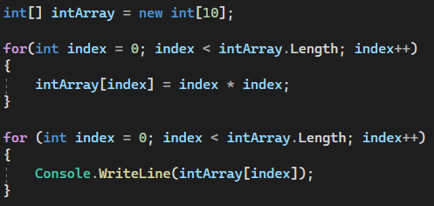
Iteration through an array
Arrays
Let's see how values can be assigned to an array by iterating through it.
It is also possible to assign values during iteration to an array whose values were assigned during initialization.

Slide 10

Arrays
Task 1
Write a method that takes a single parameter, an array of integers, and returns a new array, where each element is the square of the original array element(power by 2). For example, if the input is {1, 2, 3}, the output should be {1, 4, 9}.
Write a method that takes a single parameter, an array of integers, and returns the sum of all the elements of the array.
Write a method that takes a single parameter, an array of integers, and returns the largest element of the array.
Write a method that prints the int array from back to front.

Slide 11
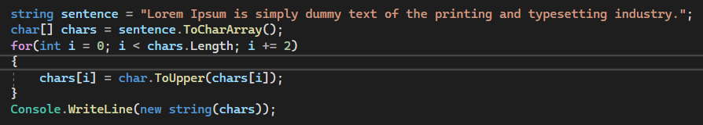
String -> char[]
Arrays
Let's see how we can turn a string variable into an array of characters char[]
The ToCharArray() method returns an array of characters created from the sentence variable.
Rotate the loop every two indices to make every second letter uppercase
Then we use the option to create a string from an array of characters and print it:

Slide 12
Arrays
Task 2
Write a method that takes one parameter, the string word, and returns a char array corresponding to the original string. For example, if the input is "hello", the output should be {'l', 'a', 'b', 'a', 's'}.
Create a method that takes one parameter, string sentence, and returns the first letter of the sentence. The function must use a char array.
Write a method that takes one parameter, string sentence, and returns the last letter of the sentence. The function must use a char array.

Slide 13
Arrays
Task 3
Advanced:
Sort the array in ascending order (do not use the Sort method, you must sign your own)
Sort the array in descending order (do not use the Sort method, you must sign your own)
Write a method to add an element to the array.
Write a method that deletes an element from the array, the array must also be reduced by one element. Useful information about sorting: https://www.geeksforgeeks.org/introduction-to-sorting-algorithm/

